Slide 1


Kammavari Sangham (R) 1952, K.S.Group of Institutions
K. S. INSTITUTE OF TECHNOLOGY, BENGALURU-560109
(Affiliated to VTU, Belagavi & Approved by AICTE, New Delhi, Accredited by NAAC & IEI)
DEPARTMENT OF COMPUTER SCIENCE AND ENGINEERING
FIRST PHASE REVIEW
PROJECT TITLE
Hand Gesture Recognition for Differently Abled People
Under the guidance of :
Dr. Deepa S R,
Associate Professor,
Department of CSE, KSIT
Team Members:
Goutham M [1KS18CS024]
Dhananjaya S [1KS18CS018]
Kiran V Dambal [1KS18CS033]
Ganesh A [1KS18CS023]
Batch Number: 2021_CSE_35
‹#›

Slide 2
CONTENTS
1.Introduction
2.Literature Survey
3.Problem Identification, Statement & Scope
4.Goals and Objectives
5.Methodology
6.Contribution to Society
7.References

Slide 3
INTRODUCTION
In recent years, the number of deaf-mute people has increased because of birth defects and other issues. Since a deaf and mute person cannot talk with an ordinary person in order that they ought to rely on some kind of communication system.
Human hand gestures provide the natural and effective mode of non-verbal conversation with the computer interface. Hand gestures are the significant body motions that are actions of hands, arms or fingers. Hand gesture identification tiers from the static gesture with the complex background or dynamic gestures that express the human feeling and talk with computer or humans. The hand is directly use as the input to the machine, for the communication purpose of gesture identification there is no need of an intermediate medium.
The aim of this project is to build up a system for hand gesture recognition that acknowledges hand gestures and then converts them into text/voice.
‹#›
‹#›

Slide 4
LITERATURE SURVEY
Sl no. | Publication Details | Problem Focused | Technique | Outcome
1. | Parshwa P. Patil, Maithili J. Phatak, Suharsh S. Kale, “Hand Gesture Recognition for Deaf and Dumb” International Research Journal of Engineering and Technology (IRJET) Volume: 06 Issue: 11 | Nov 2019 | To create a hand gesture recognition model using Machine Learning. | * Adaptive Boosting * Motion Detection * Region of Interest * Thresholding | This produced decent classification results of 73.68% with a small feature vector size containing 8 features.
2. | Kundan Kumar Dubey, Ajitanshu Jha, Akshay Tiwari, K. Narmatha, "Hand Gesture Movement Recognition System Using Convolution Neural Network Algorithm", International Research Journal of Computer Science (IRJCS) Issue 04, Volume 6 (April 2019) | Hand Gesture Detection using Convolutional Neural network and Deep Learning model. | * OpenCV * Computer Vision * Deep Learning * Inception v3 | The proposed system is capable to immediately understand hand gestures from the entire image without the use of any image region selection framework.

Slide 5
LITERATURE SURVEY
Sl no. | Publication Details | Problem Focused | Technique | Outcome
3. | Munir Oudah, Ali Al-Naji, and Javaan Chahl “Hand Gesture Recognition Based on Computer Vision: A Review of Techniques”, Journal of Imaging -23 July 2020 | To introduce a system that can detect specific human gestures and use them to convey information. | *Glove-based attached sensor. *Color recognition *Motion recognition *Deep Learn recognition *Depth recognition | Multiple studies based on computer vision techniques, and provide insight into some gesture recognition systems under various scenarios.
4. | “A Sensor-Based Hand Gesture Recognition System for Japanese Sign Language” Xianzhi Chu, Jiang Liu, School of Fundamental Science and Engineering Waseda University 2021 IEEE 3rd Global Conference on Life Sciences and Technologies (LifeTech 2021 | To use a sensor based glove to recognize the gesture and convert that into text or voice. | Five flex sensors, an Inertial Measurement Unit, and three Force Sensing Resistors (FSRs) are used to detect the bending degree of fingers and hand movement information. | This system can recognize 24 static and 2 dynamic letters with about 96.5% accuracy.

Slide 6
LITERATURE SURVEY
Sl no. | Publication Details | Problem Focused | Technique | Outcome
5. | “Design and evaluation of a hand gesture recognition approach for real-time interactions” Vaidyanath Areyur Shanthakumar Chao Peng Jeffrey Hansberger Lizhou Cao, Springer Science Publisher- 21 February 2020 | In this work, they detect and recognize in-air hand gestures, which are natural and intuitive to perform and can be used to interact with touchless user interfaces. | This is different from machine learning approach, they’re angular-velocity method do not require data preprocessing like data collection, annotation, or training. | The overall mean accuracy is 97.3%, which takes both static and dynamic gestures into account.
6. | Guillaume Devineau, Wang Xi, Fabien Moutarde, Jie Yang. “Deep Learning for Hand Gesture Recognition on Skeletal Data”. 13th IEEE Conference on Automatic Face and Gesture Recognition May 2018, Xi’An, China. | In this work, they use convolutional neural network to classify (recognize) hand gestures using skeletal data. | They introduce a new 3D hand gesture recognition approach based on a deep learning model using Convolutional Neural Network (CNN) where sequences of hand-skeletal joints’ positions are processed by parallel convolutions. | Our model achieves a 91.28% classification accuracy for the 14 gesture classes case and an 84.35% classification accuracy for the 28 gesture classes case.

Slide 7
PROBLEM IDENTIFICATION
The Differently Abled People in the society today find it difficult to have a proper conversation without the help of a translator.
They also need assistance in public places to perform simple tasks.
They find it difficult to effectively communicate with a person who does not know anything about sign language.
This above problem is seen in India. And there are no proper tools available for this community to communicate effectively.

Slide 8
PROBLEM STATEMENT
“ To design a Deep Learning Model which will recognize the hand gestures of Differently Abled People and then convert the gestures into text or voice ”

Slide 9
SCOPE
The proposed system focuses on hand gestures which is accepted by Indian Sign Language Organization and tries to recognize the same which is then converted to text or speech.
We are going to create our own dataset for the static gestures and dynamic gestures.
We will use pre existing datasets for Alphabets and Numbers.
The datasets used are:
https://www.kaggle.com/abdullahmujahidali/hand-gesture-recongition-yolo-v3?select=234.JPG
https://www.kaggle.com/muhammadkhalid/sign-language-for-alphabets

Slide 10
GOALS AND OBJECTIVES
The main goal is to build a model using deep learning algorithms that can be used to recognise hand gestures and convert it into text or voice.
To help them to feel more independent, we are trying to remove human assistance and provide a system which gives them text or voice based output for their hand gestures.
We will also create an API for our proposed model which will enable other developers to use this tool in their projects. (Ex: Online Meeting Platform)
To provide a Web based or Android Application for our users to effectively used our model in their day to day lives.

Slide 11
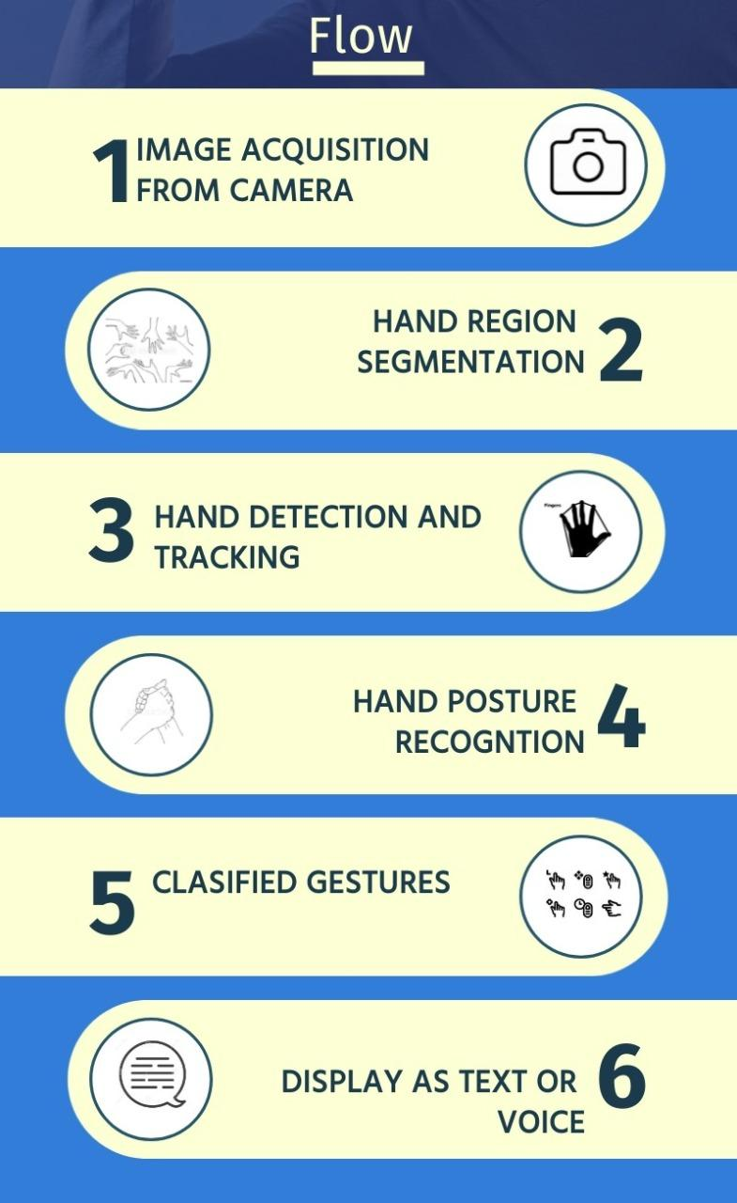
METHODOLOGY
To begin, we will be using OpenCV to capture the hand gesture images through a Computer/Mobile camera.
This captured images will be segmented and only the gesture part of the hand is stored in the database.
This image is now fed to the model which will use tensorflow to classify the image.
After this the model recognises the gesture using the images in the dataset.
Now, for training and testing our model. We use at least 30-40 images per gesture. Here most of the images, say 80% is used for training our model and 20% is used for testing.
Once the training is complete, in the testing phase, we try to display the gestures as text or voice based output.

Slide 12
CONTRIBUTIONS TO SOCIETY
Hand gesture recognition will enable differently abled community to effectively communicate and interact with normal people.
It creates sense of equality in society among the people.
This creates more professional opportunities for differently abled community.

Slide 13
REFERENCES
[1] “Hand Gesture Recognition for Deaf and Dumb” ,Parshwa P. Patil, Maithili J. Phatak, Suharsh S. Kale,International Research Journal of Engineering and Technology (IRJET) Volume: 06 Issue: 11 | Nov 2019
[2] "Hand Gesture Movement Recognition System Using Convolution Neural Network Algorithm", Kundan Kumar Dubey, Ajitanshu Jha, Akshay Tiwari, K. Narmatha, International Research Journal of Computer Science (IRJCS) Issue 04, Volume 6 (April 2019)
[3] “Hand Gesture Recognition Based on Computer Vision: A Review of Techniques”,Munir Oudah, Ali Al-Naji, and Javaan Chahl, Journal of Imaging -23 July 2020
[4] “A Sensor-Based Hand Gesture Recognition System for Japanese Sign Language”, Xianzhi Chu, Jiang Liu, School of Fundamental Science and Engineering Waseda University 2021 IEEE 3rd Global Conference on Life Sciences and Technologies (LifeTech 2021
[5] “Design and evaluation of a hand gesture recognition approach for real-time interactions”, Vaidyanath Areyur Shanthakumar Chao Peng Jeffrey Hansberger Lizhou Cao, Springer Science Publisher- 21 February 2020
[6] “Deep Learning for Hand Gesture Recognition on Skeletal Data”, Guillaume Devineau, Wang Xi, Fabien Moutarde, Jie Yang. . 13th IEEE Conference on Automatic Face and Gesture Recognition May 2018, Xi’An, China.

Slide 14


